Slide 1
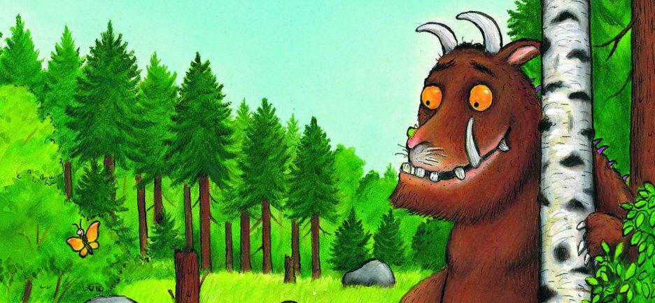
Today we are going to find one more and one less.

Slide 2
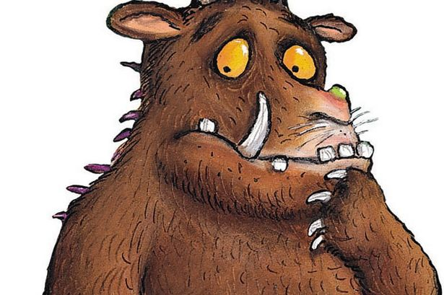
The Gruffalo is hungry…

Slide 3

…REALLY hungry!
Which plate has more food?
10
7

Slide 4
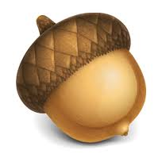
Mouse only has a small tummy…
Which plate has less food?
8
5

Slide 5
Gruffalo is still hungry!
Let’s give the Gruffalo1 more mouse.
6
1 more than 5 is

Slide 6
Mouse can’t eat all that!
Let’s give the Mouse1 less nut.
5
1 less than 6 is

Slide 7
Now can you help the Gruffalo and Mouse get the right amount of food?

Slide 8
Give mouse 1 less nut…
1 less

Slide 9
Give Gruffalo 1 more mouse…
1 more

