Slide 1
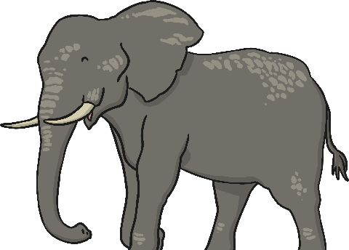
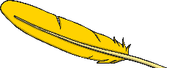
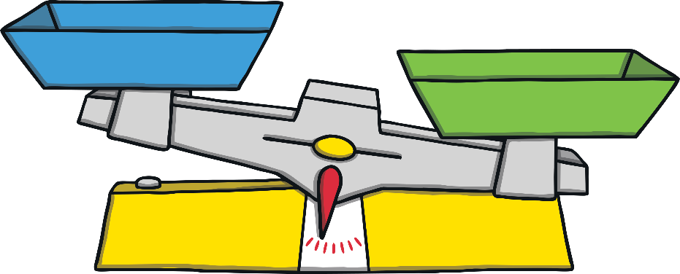
What Is Weight?
Weight is how heavy something is.
Some things are really heavy, like an elephant.
Some things are really light, like a feather.
Weight is measured using a balance or scales.
Have a look at the next few slides and see if you can identify which object is heavier and which is lighter.

Slide 2
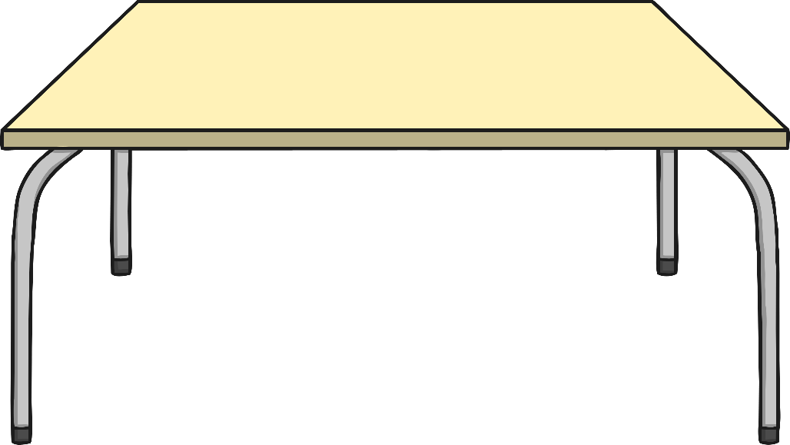
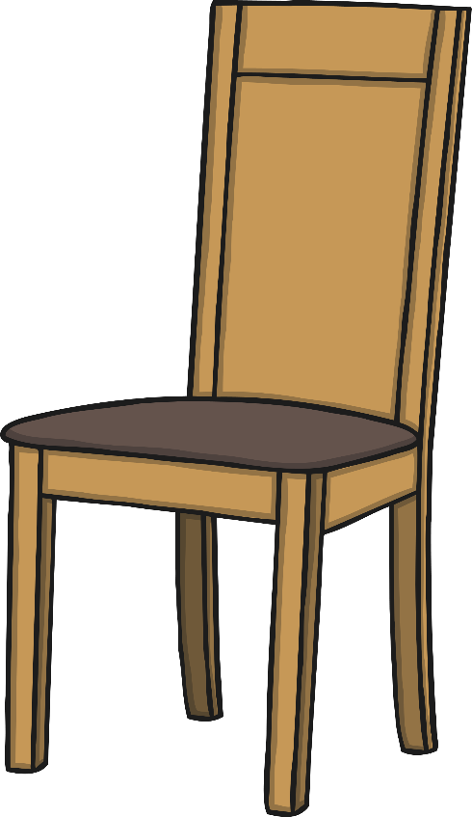
Which object is heavier?

Slide 3
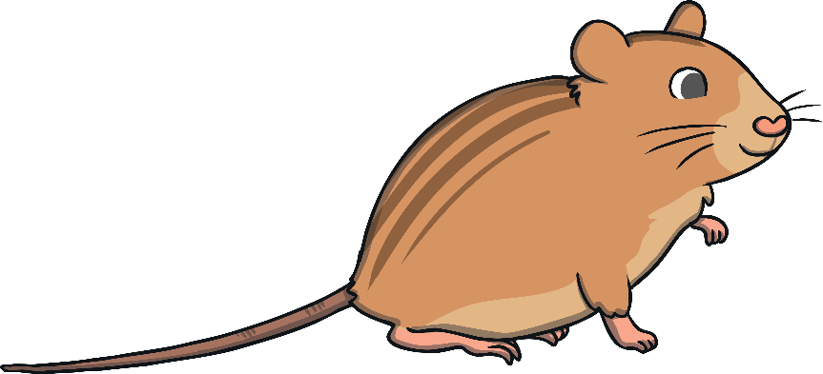
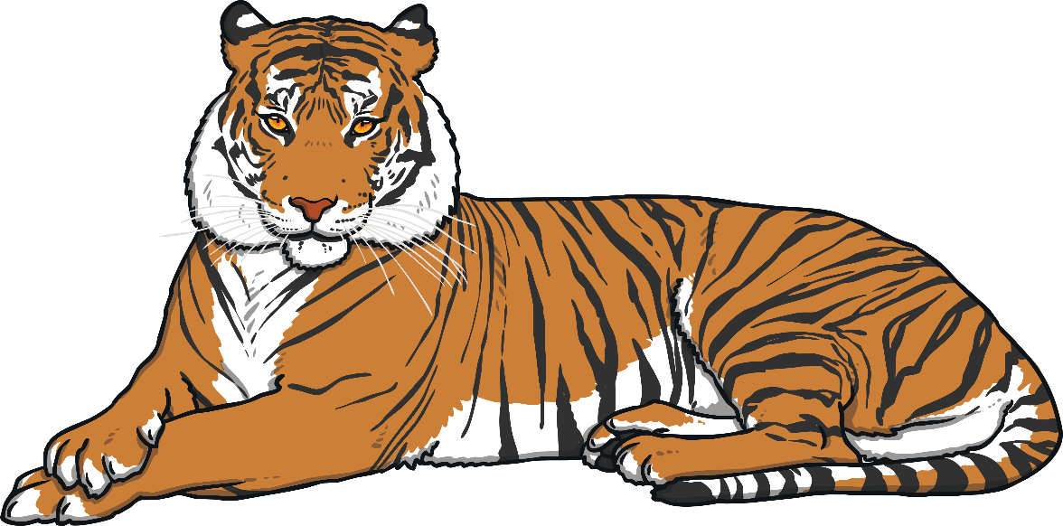
Which animal is lighter?

Slide 4


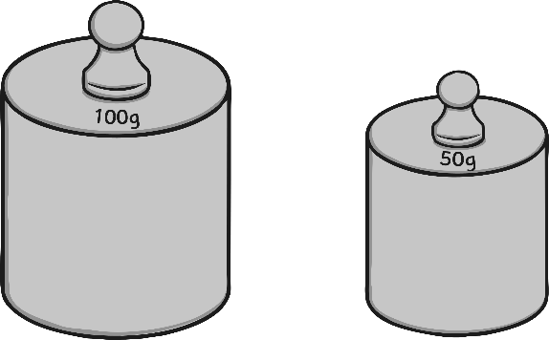
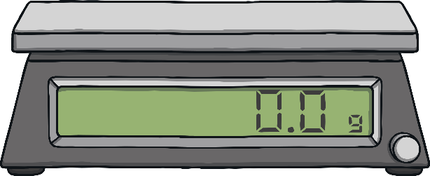
Weighty Words
less than
equal to
more than
lightest
heavier
We use lots of different words when we talk about weight. Can you think of any more?
the same as
heaviest
lighter

Slide 5

How Does a Balance Work?
If we want to measure which of two items is the heavier or the lighter, we use a balance in the following way:
We put the two items we are measuring on the balance, one on each side.
The item that is heavier will be lower than the lighter one.
The item that is lighter will be higher than the heavier one.
Look at this balance. The elephant is heavier than the butterfly.

Slide 6

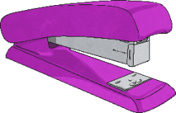
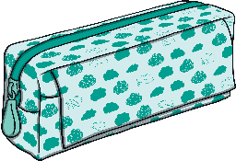
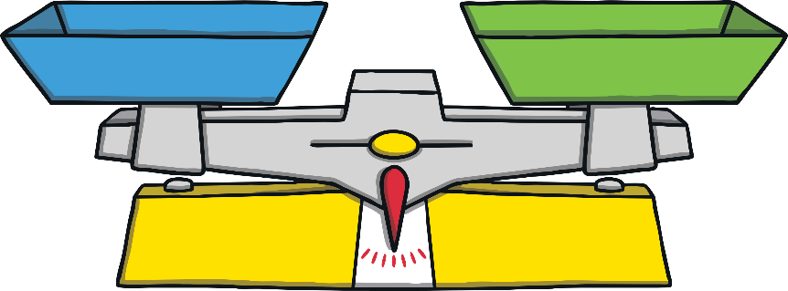
Find and compare the mass of the objects.
4
The pencil case weighs
marbles.
The stapler weighs marbles.
6
lighter
The stapler is than the pencil case.

Slide 7

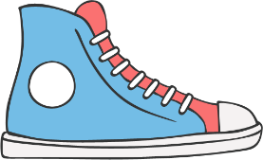
Find and compare the mass of the objects.
11
15
The shoe weighs marbles.
The book weighs marbles.
heavier
The book is than the shoe.

Slide 8
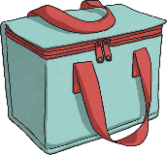



Find and compare the mass of the objects.
The stapler
weighs
marbles.
The laptop
weighs
marbles.
The lunch box weighs
marbles.
11
16
14
lightest
The stapler is the .
heaviest
The laptop is the .

Slide 10
These are the most common measurements:
Grams (g)
Kilograms (kg)
Tonnes (t)

Slide 11
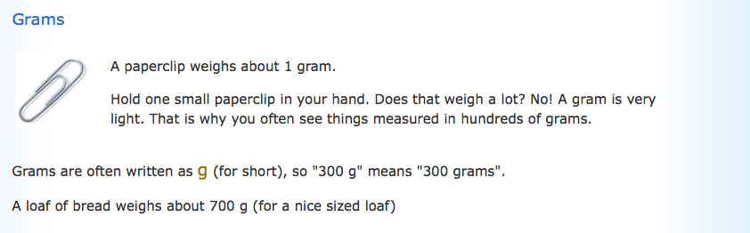
Grams

Slide 12
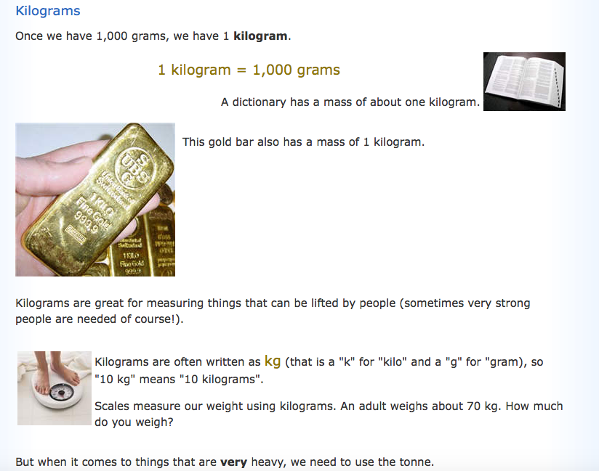
Kilograms

Slide 13
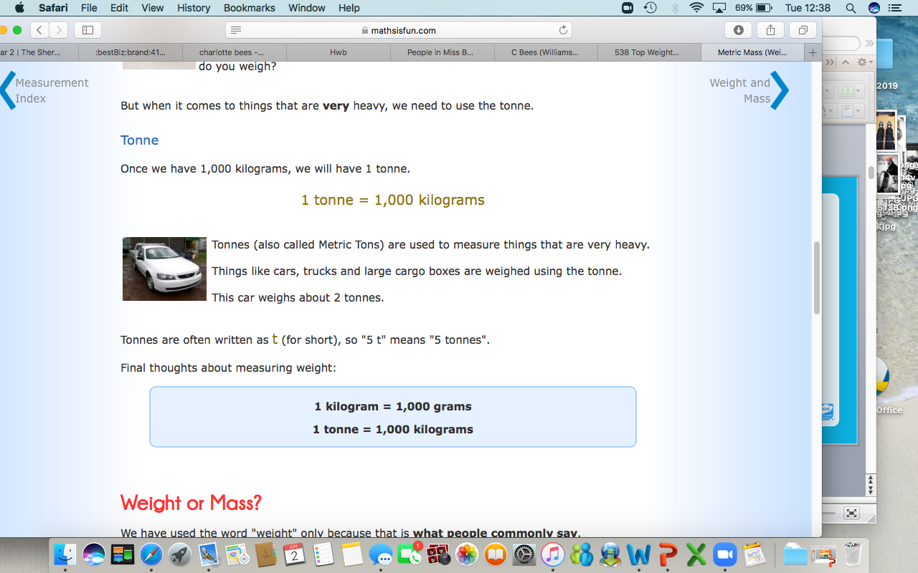
Tonnes

Slide 14
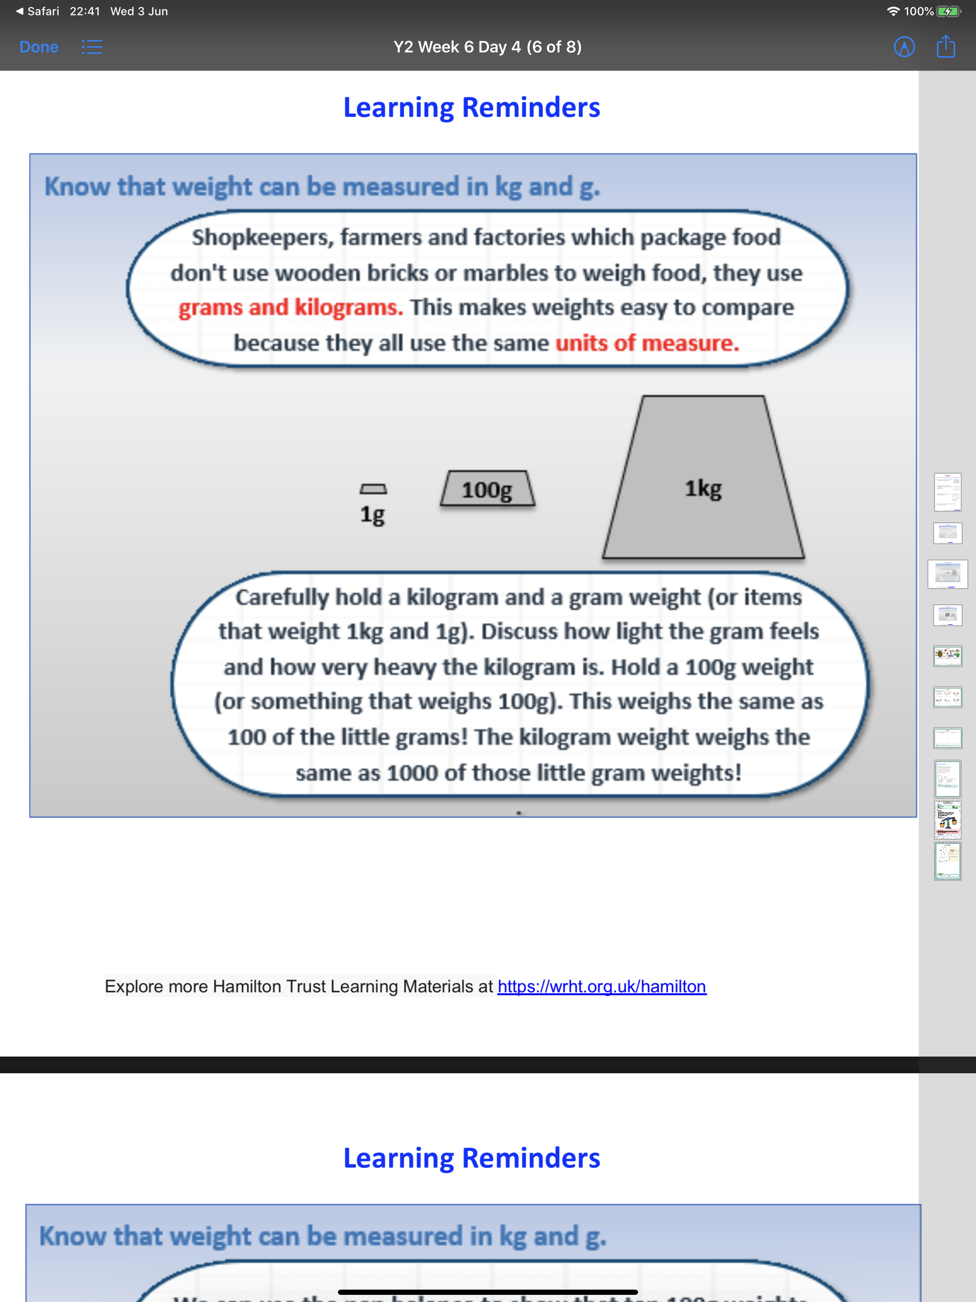

Slide 15
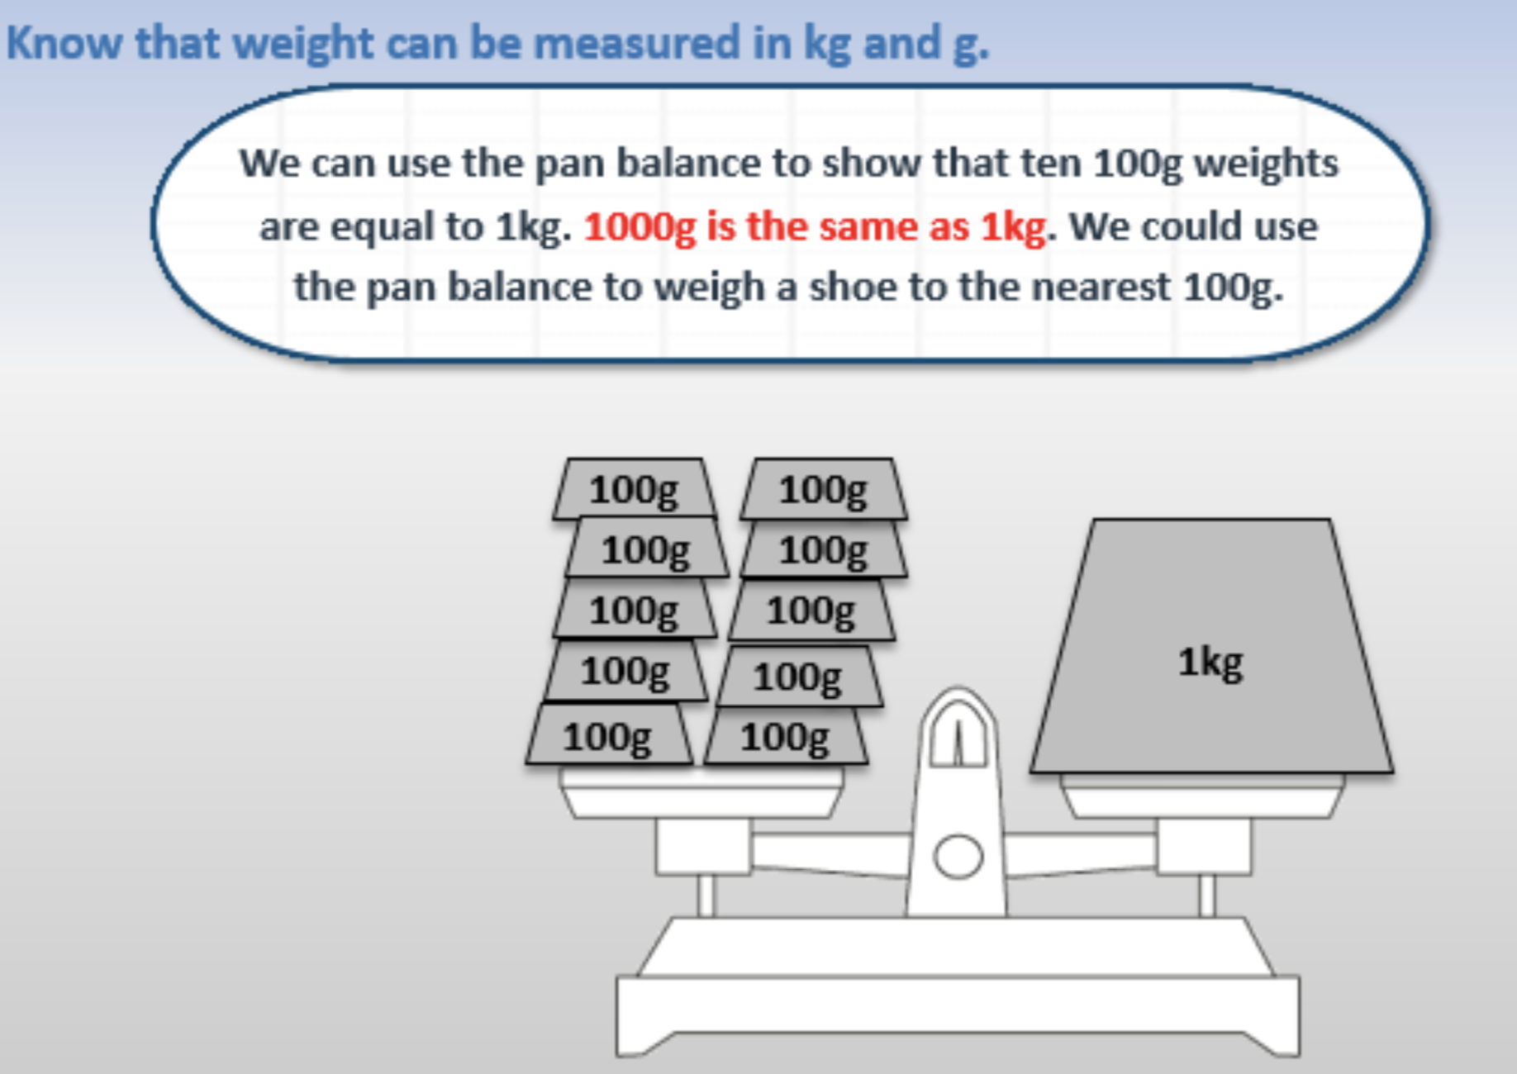

Slide 16
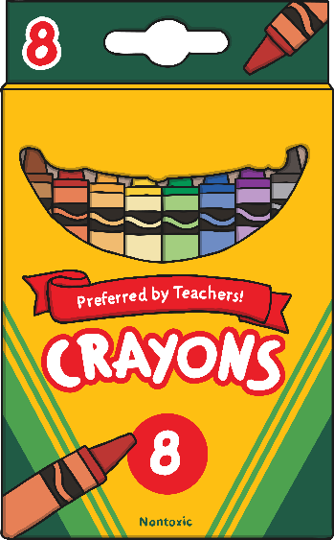
…a packet of crayons?
g
kg
ton

Slide 17

Correct! Well done!

Slide 18
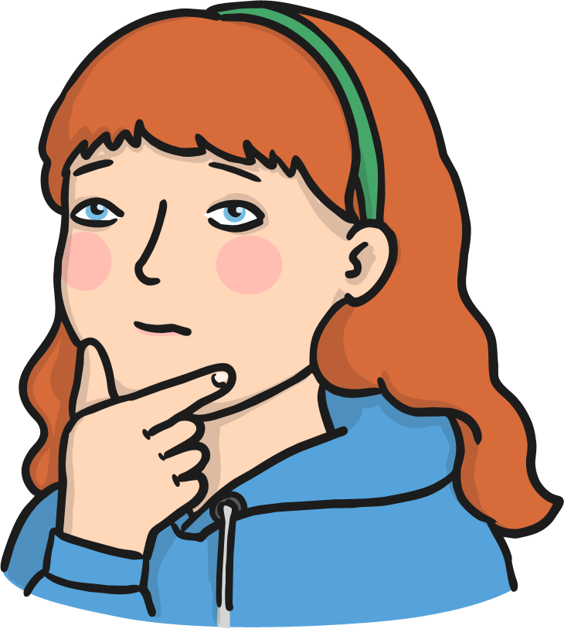
Oh no! Try again!

Slide 19
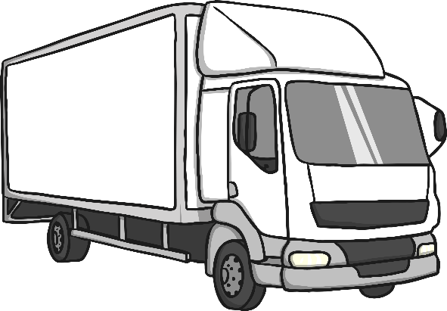
…a lorry?
g
kg
ton

Slide 20
Correct! Well done!

Slide 21
Oh no! Try again!

Slide 22
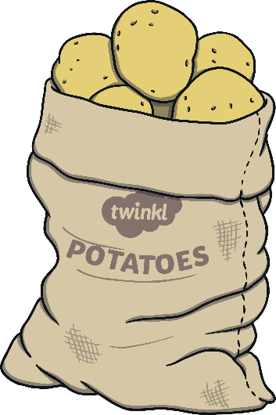
…a bag of potatoes?
g
kg
ton

Slide 23
Correct! Well done!

Slide 24
Oh no! Try again!

Slide 25
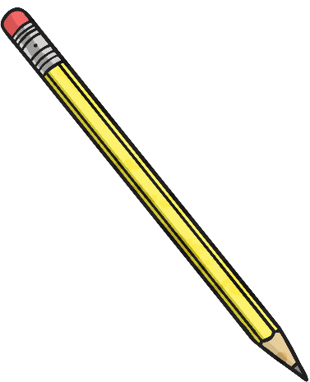
…a pencil?
g
kg
ton

Slide 26
Correct! Well done!

Slide 27
Oh no! Try again!

Slide 28
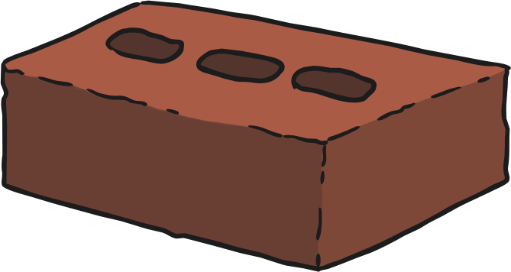
…a brick?
g
kg
ton

Slide 29
Correct! Well done!

Slide 30
Oh no! Try again!

