Slide 1
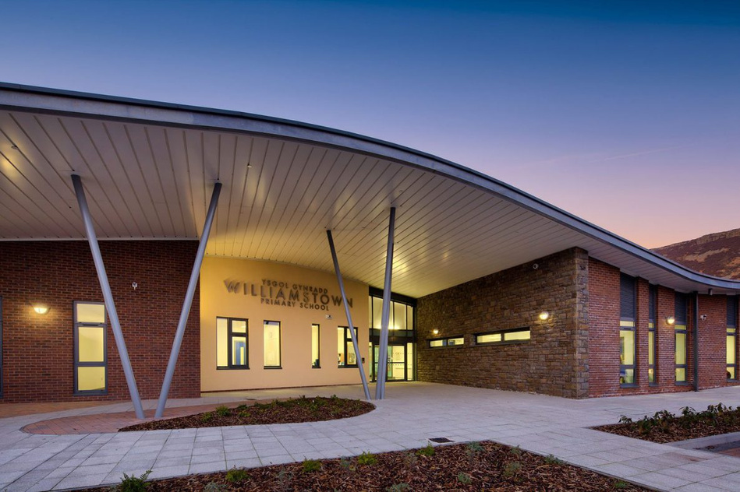
WPS NEWS
June 2025
"Summer is a time to grow, explore, and shine—just like our amazing pupils! Keep learning, keep laughing, and let your imagination soar."
Welcome back to what is going to be an incredibly busy half term. We have already seen our year 5 pupils leave and return from their Llangrannog residential. The weather was kind to them and they had an incredible time. Thanks to Miss Densley, Mr Lewis and Mrs Roberts who accompanied them on the residential. Year 6 are also looking forward to their London residential and, not to mention, the summer show, which will be held at 2 pm on Wednesday 9th, Thursday 10th and Friday 11th July. It is certainly one not to miss and tickets will be on sale very soon through RCT Pay.
Thank you for your support and patience this week as we have moved to new arrangements for the beginning of the day. I hope that these changes have helped you in the morning! A reminder that all children should be in school by 9:00am.
Fete
This Year’s Summer fete will be on Thursday 17th July and will start at 1pm. This year, we are hoping to make it even bigger and better. If you, or anyone you know would like a stall, please contact the school office.
If you are able to help out on one of the stalls or in any of the organisation then the PTA will be meeting on Wednesday 18th June at 2pm in school.
Proud to Present
Your child should have come home with an invite to “proud to present” This is an opportunity for your child to present their work to you so that you can see the progress they have made over the year. You would have been allocated either Monday 16th June or Tuesday 17th June – Will be great to see as many of you there as possible.
This year, our Sports Day will be held on the field on Friday 20th June. There will be refreshments available for purchase on the day, though please be aware that no seating will be provided, so we encourage you to bring anything you may need for your own comfort.
Nursery & Reception: 9:30 – 10:30am
Year 1 - Year 3: 11:00 – 12:00pm
Year 4 – Year 6: 1:15 – 2:15pm
Sports Day
Parking
Parking continues to be an issue at the start and end of the day. I will be looking for a number of people to be part of a parent-school working group in the Autumn term to look at these long standing issues so that we can ensure the safety of all of our pupils, staff and families.

Slide 2
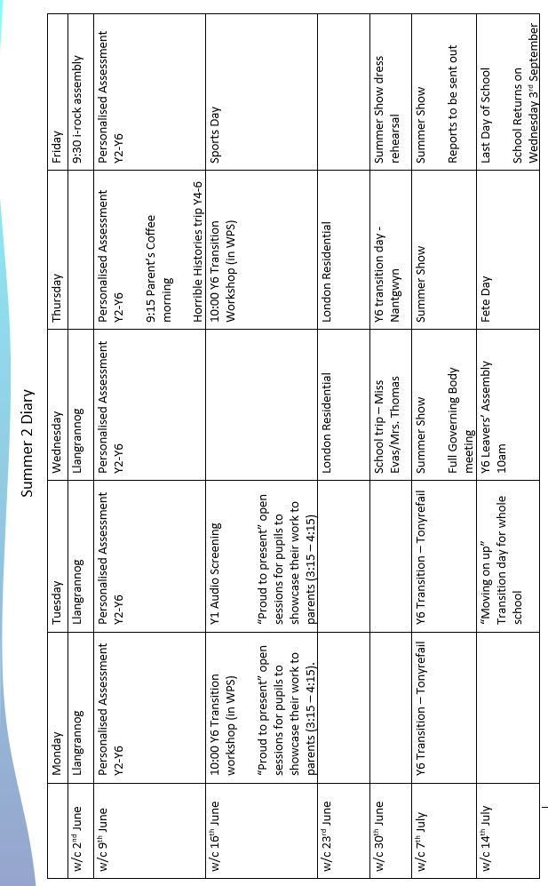
Summer Term Diary

Slide 3


=
School term date for next academic year 2025/2026
Term | From | To
Autumn 2025 | Monday, September 1 2025 | Friday, October 24 2025
Half Term | Monday, October 27 2025 | Friday, October 31 2025
Autumn 2025 | Monday, November 3 2025 | Friday, December 19 2025
Christmas Holidays | Monday, December 22 2025 | Friday, January 2 2026
Spring 2026 | Monday, January 5 2026 | Friday, February 13 2026
Half Term | Monday, February 16 2026 | Friday, February 20 2026
Spring 2026 | Monday, February 23 2026 | Friday, March 27 2026
Easter Holidays | Monday, March 30 2026 | Friday, April 10 2026
Summer 2026 | Monday, April 13 2026 | Friday, May 22 2026
Half Term | Monday, May 25 2026 | Friday, May 29 2026
Summer 2026 | Monday, June 1 2026 | Monday, July 20 2026
Next year, we will have 6 INSET days.
Monday 1st September 2025
Tuesday 2nd September 2025
Friday 22nd May 2026 – Cluster INSET day
Monday 20th July 2026
2 other dates are to be confirmed
Making a difference together

Slide 4


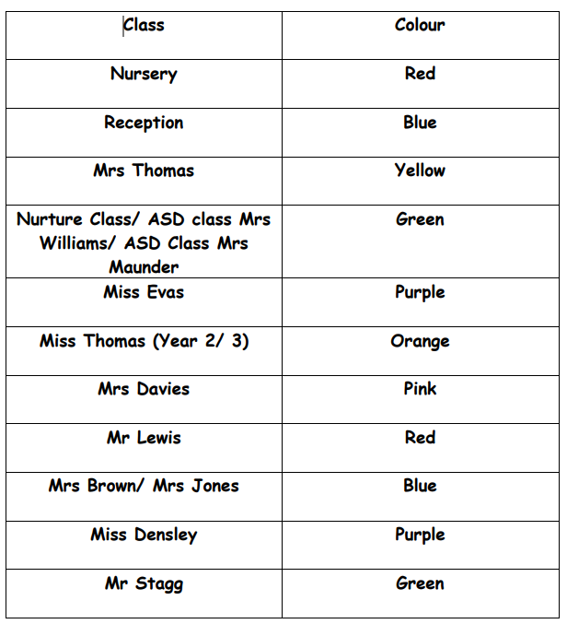
Please see the colour for each class below – Items should be sent in by Friday 4th July so we can combine all of the hampers ready for the day – thank you

Slide 5


