Slide 1
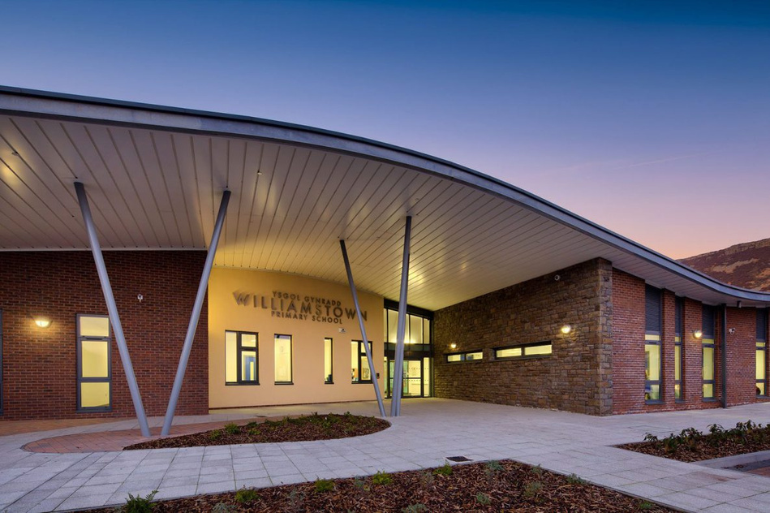
WPS NEWS
May 2025
"A school is strongest when everyone—staff, pupils, families, and governors—works as one. Together, we create a community where every child can thrive, every voice is heard, and every effort makes a difference."
Thank you!
I wanted to thank you all again for your welcome over the past two weeks. It has been lovely to speak with so many you and I am looking forward to us working together to make Williamstown Primary School the very best it can be for all of your children. On Thursday 12th June at 9:15, I will be holding a drop-in coffee morning in our school hall. This will be an opportunity to have a chat about your hopes for the school and ideas on how we can make WPS even better! It would be great to see you there so that I can introduce myself properly and share with you the vision I have for Williamstown Primary School.
Morning Changes
From Monday 2nd June we will be changing our morning drop-off times. All children across the school will now be able to enter their classrooms from 8:50 am (Gates will open at 8:45 and close at 9:00am). This has been done to make the morning drop-off routines that little bit easier for you. Any child arriving after this time, will need to come through the main entrance.
A further letter will follow next week.
Celebration
Every Friday we hold our “Seren Yr Wythnos” (Star of the week) assembly where one child from each class is awarded a certificate for going above and beyond in their learning. This is a lovely assembly where we all get to share each other’s’ achievements. If your child is involved in any outside clubs or lessons and they would like to share any awards, certificates or medals, then please do send them in on a Friday so that we can celebrate with them.
These will also be shared with you in our new monthly newsletter
Safeguarding Team
We all have a duty of care to make sure every child is free from neglect or abuse. If you have any concerns, then you can talk confidently to a member of our Safeguarding team. Mr. Anstee (Safeguarding Lead), Mrs. Brown, Mr. Lewis, Mrs. Clement and Mrs. Thomas Samantha Morgan is our Safeguarding Lead Governor

Slide 2


=
Dates for the diary
Tuesday 29th April – Term Begins
Monday 5th May – Bank Holiday – school closed
Thursday 22nd May – Last day
Friday 23rd May – INSET day – school closed
Monday 2nd June – School returns
2-4th June Y5 Llangrannog residential
20th June - Sports Day (More information to follow)
25th/26th June – Y6 London residential
4th July Summer show dress rehearsal
7th, 10th and 11th July – Y6 Summer Show (More information to follow)
Friday 18th July – End of Summer Term
Monday 21st July – INSET day – no school
Wednesday 3rd September – School returns
School term date for next academic year 2025/2026 – INSET dates for next year will follow shortly
Term | From | To
Autumn 2025 | Monday, September 1 2025 | Friday, October 24 2025
Half Term | Monday, October 27 2025 | Friday, October 31 2025
Autumn 2025 | Monday, November 3 2025 | Friday, December 19 2025
Christmas Holidays | Monday, December 22 2025 | Friday, January 2 2026
Spring 2026 | Monday, January 5 2026 | Friday, February 13 2026
Half Term | Monday, February 16 2026 | Friday, February 20 2026
Spring 2026 | Monday, February 23 2026 | Friday, March 27 2026
Easter Holidays | Monday, March 30 2026 | Friday, April 10 2026
Summer 2026 | Monday, April 13 2026 | Friday, May 22 2026
Half Term | Monday, May 25 2026 | Friday, May 29 2026
Summer 2026 | Monday, June 1 2026 | Monday, July 20 2026
Making a difference together

