Slide 1


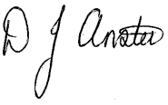
WILLIAMSTOWN PRIMARY SCHOOL
Dinas Isaf West, Tonypandy,
CF40 1AG
Tel: 01443 432186
admin@williamstownprimary.rctcbc.cymru
Monday 3rd November
Dear Parents and Carers,
Welcome back to the Christmas term! We hope you had a restful half-term break and are feeling refreshed for the exciting weeks ahead.
Firstly, thank you to all families who took the time to respond to our recent communication survey. Your feedback is incredibly valuable and helps us to improve how we connect with you. As a direct result of your input, we are pleased to be able to provide you with a regular monthly newsletter. This will include key information for the term ahead, as well as highlights and celebrations from the previous month. We hope this will help keep everyone informed and involved in school life.
We also recognise the importance of consistency in how learning is shared between school and home. Over the coming weeks, we’ll be exploring ways to ensure that all classes have a clear and consistent approach to sharing pupils’ work and achievements with families. We look forward to working together to strengthen this connection.
As we enter the festive season, we’re excited about the many joyful events and activities planned for the Christmas term. It’s always a special time in school, and we can’t wait to celebrate with our pupils and community.
We’re also proud to be a newly committed member of the Penrhiwfer and Williamstown partnership. This community collaboration marks an exciting new chapter for us as we seek to build a real sense of Cynefin within the school and across the communities that we serve. We’re thrilled to announce our first joint Community Christmas Event, which will take place on Tuesday 16th December .More details will follow soon, but we hope to see many of you there as we come together to celebrate the season.
Thank you, as always, for your continued support. We look forward to a term filled with learning, laughter, and festive cheer.
Sincerely,
Mr D. Anstee
Headteacher
Making a difference together

Slide 2
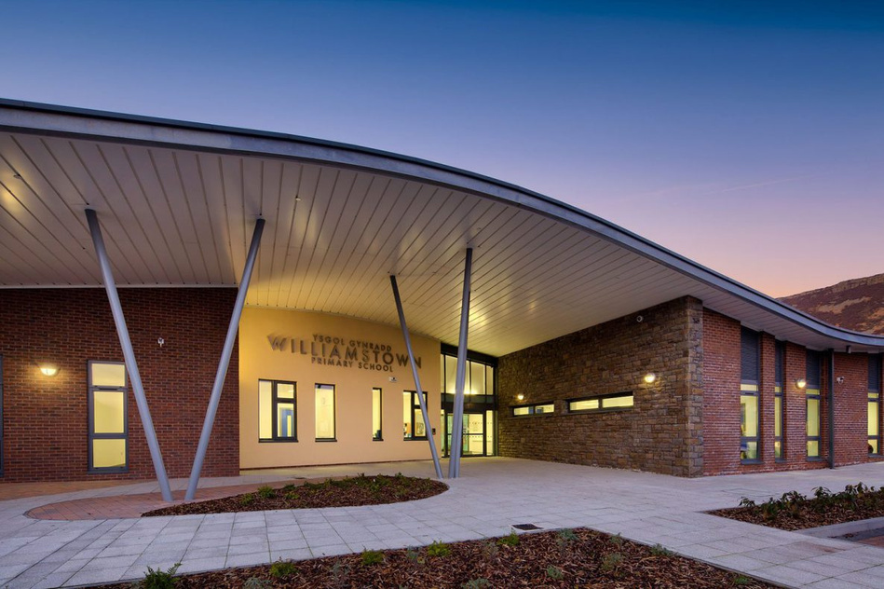
WPS NEWS
November 2025
Attendance
Last year, our attendance figure across the school was 89.83%. This meant that 9095 sessions or 4547.5 days were lost in total to absence last year.
At Williamstown Primary, we believe that every school day is a chance to learn, grow, and connect. Regular attendance helps children build routines, develop friendships, and make the most of their learning opportunities. We’re encouraging all families to support good attendance by aiming for 100% each week. Even one day missed can mean important learning is lost — so let’s work together to make every day count!
Every Minute Matters
We understand that mornings can be a challenge — especially with busy routines and unexpected delays. However, arriving just 10 minutes late each day adds up to over 30 hours of lost learning across the school year. Every minute in school is valuable. Being on time helps children settle into their day calmly, connect with their classmates, and make the most of their learning.
From tomorrow, any child arriving after the closure of the school gates will need to be signed in by a parent/carer on the iPad at reception.
Thank you for your efforts in helping your child arrive on time — it really does make a difference!
Wild Play After-School Club
Tuesday 3:15 – 4:15
This club is open for children from Year 3 – Year 6 and is fully funded by us!
There are a maximum of 16 places for this club so, if you would like your child to take part, then please follow the link:
https://forms.gle/RhJ5BLHA6k94A8BRA
Christmas Concert Dates
Tuesday 9th Dec @2pm – Y1 and Y2
Wed 10th Dec @ 2pm Nursery and Reception
Thurs 11th and Fri 12th Dec @ 2pm – Y3, Y4, Y5, Y6
Poppy Appeal
Items for this years poppy appeal are on sale from tomorrow – Thank you to Miss Galliford for leading this.

Slide 3
=
=
Dates for next half term
w.c. | Mon | Tues | Wed | Thu | Fri
3rd Nov | Forest School Sessions ND/HT begin | Forest School Sessions DS/DJ begin Governing Body Meeting
10th Nov |  |  |  |  | Children in Need – Pyjama Day/Wacky Hair
17th Nov |  | Parents Meetings | Parents Meetings | Techniquest Y3/Y4 | Techniquest Y5/6
24th Nov |  |  | New Nursery Starters
1st Dec |  | N/R School Trip | Christmas Dinner and Jumper Day | i-Rock Concert | ASC2 Class – Santa trip
8th Dec |  | Y1/2 Christmas Concert | N/R Christmas Concert | Y3-6 Christmas Concert | Y3-6 Christmas Concert
15th Dec | Y1/2 Santa Trip | Community Christmas event 3:30-5:00 |  | Y3 Panto Trip | Last day of term
Making a difference together

Slide 4

Forest Schools
Forest Schools sessions will be undertaken next term as part of the curriculum and will be led by “Wild Play” :
  Every Monday - Miss Densley and Miss Thomas’ class
  Every Tuesday – Mrs Jones and Mr Stagg’s class
Children will get muddy and wet (That is half the fun) –The activities will happen come rain or shine so please send your child into school with a waterproof coat, a bag containing old jogging bottoms/t-shirt/jumper and trainers or wellies. Please make sure to label these items.
Wild Play After-School Club
Tuesday 3:15 – 4:15
This club is open for children from Year 3 – Year 6 and is fully funded by us!
There are a maximum of 16 places for this club so, if you would like your child to take part, then please follow the link:
https://forms.gle/RhJ5BLHA6k94A8BRA

