Slide 1


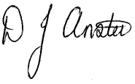
WILLIAMSTOWN PRIMARY SCHOOL
Dinas Isaf West, Tonypandy,
CF40 1AG
Tel: 01443 432186
admin@williamstownprimary.rctcbc.cymru
Thursday 16th October, 2025
Dear Parents and Carers,
As we approach the end of the first half term of the academic year, I wanted to take a moment to reflect on what has been a truly joyful start. It has been wonderful to see your children settle back into school life with such enthusiasm and positivity. The progress they are already making is incredible, and we are excited to see how this continues as the year unfolds.
This half term has been packed with enriching experiences. We celebrated Harvest with a visit to our local church, where the children showed great respect and community spirit. Our school choir has lifted our spirits with their beautiful singing, and the visit from Image Theatre brought drama and storytelling to life in a way that captivated every child.
.
We are also thrilled to have begun developing our brand-new Forest Schools area—an exciting space that will support outdoor learning and exploration. Music continues to be a vibrant part of our school, with i-Rock and peripatetic lessons now in full swing. It’s been a delight to hear music echoing through the corridors!
Looking ahead to next week, the energy continues. We’re pleased to welcome back John Newman Photography for individual school photos—something many of you requested last year. We’re glad to be able to respond to your feedback and continue this tradition at WPS.
Thank you for your continued support. We wish you and your families a restful and enjoyable half term break when it arrives.
Sincerely,
Mr D. Anstee
Headteacher
Making a difference together

Slide 2
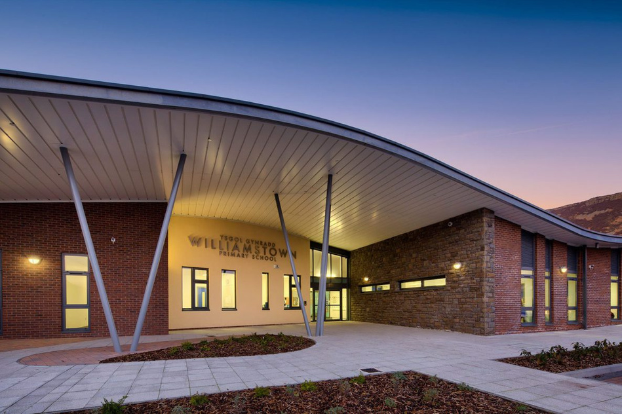
WPS NEWS
OCtober 2025
Exciting Times
We’re thrilled to announce the development of a brand-new Forest School area, made possible by a generous £7,000 grant. This outdoor learning space will eventually be used by all children across the school, offering hands-on experiences in nature that support wellbeing, creativity, and resilience. Forest School sessions will begin after half term for Years 4–6, with an after-school club also launching soon—more details to follow next week!
In addition, we’re working closely with the local authority to redevelop our much-loved Heart Space within the school. Provisional plans have already been drawn up, and we’ll be sharing these with a group of children to gather their thoughts and ideas. This is their space, and it’s vital that their voices are heard as we shape a welcoming, inclusive environment that reflects their needs and aspirations.
What’s happening next week?
Tuesday 21st – Police Visit to Nursery and Reception
Tuesday 21st – Y6 Lifesaving
Wednesday 22nd – Y6 British Sign language lessons
Wednesday 22nd - Movie Nights – Reception to Year 6 (Please remember that children must be collected by an appropriate adult at 5:00pm. No child will be permitted to walk home alone.)
Wednesday 22nd – School Photos with John Newman
Thursday 23rd - Year 5/6 Football Festival at Ysgol Nantgwyn (Permission slips have been sent to those taking part)
Thursday 23rd – Nasal Flu Vaccines
Friday 24th - South Wales Fire Visit to Nursery, Reception, Year 2 and Year 5
Friday 17th October – Show Racism the Red Card
We are proud to support Show Racism the Red Card tomorrow. Children are encouraged to wear red to show their support for this important cause.
Christmas Concert Dates
(Yes I know it’s only October)
Tuesday 9th Dec @2pm – Y1 and Y2
Wed 10th Dec @ 2pm Nursery and Reception
Thurs 11th and Fri 12th Dec @ 2pm – Y3, Y4, Y5, Y6

Slide 3
=
Dates for next half term
Autumn 2 Begins – Monday 3rd November
Parents Consultations – Week Beginning 17th November (More info to follow)
Wednesday 19th November – Autumn term Governing Body Meeting
Wednesday 26th November @1:30 – Pre-Nursery new starters
Tuesday 2nd December – Phase 1 –Breakfast with Santa in Dragon’s Den
Wednesday 3rd December – Christmas Dinner and Jumper Day (Donation to Save the Children)
Thursday 4th December @2:30 - i-Rock concert for parents of participating pupils
Tuesday 9th – Friday 12th - Christmas Concert week (see page 2 – Tickets will be released after half term)
INSET Day – Monday 5th January
Spring 1 Begins – Tuesday 6th January
School term date for next academic year 2025/2026 –
Entrepreneurial Fortnight:
December is always a busy and expensive time for parents and families. With this in mind, we will be moving our entrepreneurial fortnight and event to the end of the Spring Term. We know how many of you enjoy the Christmas Fayre but we also appreciate how difficult it is for parents to get time off work and spend out on crafts and other items at this time.
Our Spring event will have a community focus (Cynefin) and will seek to bring the whole school community together for a fun-packed event.
Look out for more information after Christmas!
Term | From | To
Autumn 2025 | Monday, September 1 2025 | Friday, October 24 2025
Half Term | Monday, October 27 2025 | Friday, October 31 2025
Autumn 2025 | Monday, November 3 2025 | Friday, December 19 2025
Christmas Holidays | Monday, December 22 2025 | Friday, January 2 2026
Spring 2026 | Monday, January 5 2026 | Friday, February 13 2026
Half Term | Monday, February 16 2026 | Friday, February 20 2026
Spring 2026 | Monday, February 23 2026 | Friday, March 27 2026
Easter Holidays | Monday, March 30 2026 | Friday, April 10 2026
Summer 2026 | Monday, April 13 2026 | Friday, May 22 2026
Half Term | Monday, May 25 2026 | Friday, May 29 2026
Summer 2026 | Monday, June 1 2026 | Monday, July 20 2026
Making a difference together

Slide 4

Forest Schools
Forest Schools sessions will be undertaken next term as part of the curriculum and will be led by “Wild Play” :
  Every Monday - Miss Densley and Miss Thomas’ class
  Every Tuesday – Mrs Jones and Mr Stagg’s class
Children will get muddy and wet (That is half the fun) –The activities will happen come rain or shine so please send your child into school with a waterproof coat, a bag containing old jogging bottoms/t-shirt/jumper and trainers or wellies. Please make sure to label these items.
Wild Play After-School Club
Tuesday 3:15 – 4:15
This club is open for children from Year 3 – Year 6 and is fully funded by us!
There are a maximum of 16 places for this club so, if you would like your child to take part, then please follow the link:
https://forms.gle/RhJ5BLHA6k94A8BRA

