Slide 1
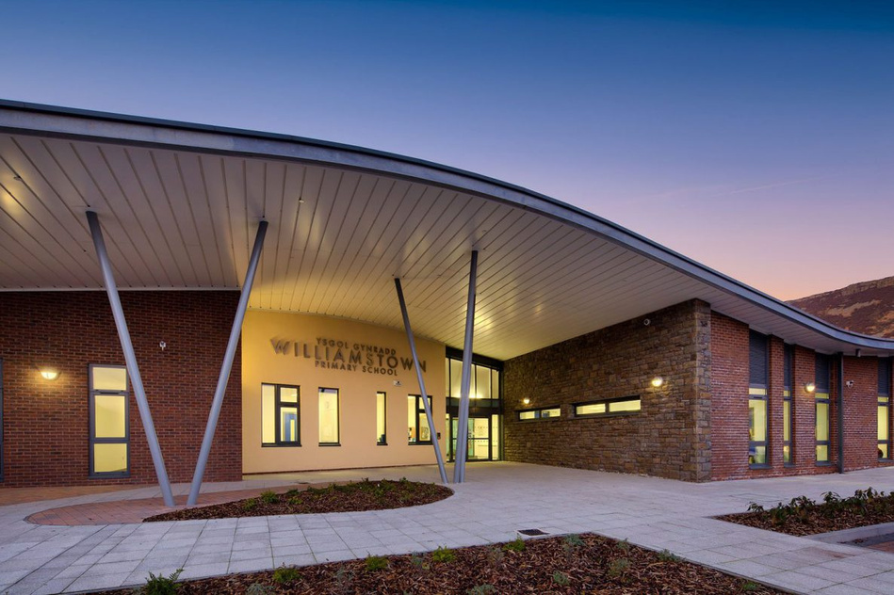
WPS NEWS
September 2025
"The beautiful thing about learning is that no one can take it away from you.“ — B.B. King
Croeso Nol – Welcome Back
Welcome back to a brand-new school year at Williamstown Primary School! I hope you all had a restful and enjoyable summer break. It’s wonderful to see our school full of life again as we welcome both returning families and those joining us for the first time.
Our staff team have been working hard to ensure a smooth and exciting start to the term. We’re especially delighted to welcome our new Nursery pupils, who are settling in beautifully and already showing great enthusiasm for learning.
How You Can Help
We deeply value the partnership between home and school, and there are many ways you can support your child’s learning and contribute to our school community:
Reading at Home: Regular reading with your child makes a huge difference. Just 10 minutes a day can boost confidence and comprehension.
Attendance & Punctuality: Being on time and attending regularly helps children feel secure and ready to learn.
Stay Involved: Keep an eye out for upcoming opportunities to join a relaunched “Friends of WPS” group and a new and exciting Parent Council as we seek your support in helping WPS become the best it can be for all of our learners and wider community.
Communication: If you have any concerns or suggestions, please don’t hesitate to speak with your child’s teacher or phase lead.
Safeguarding Team
We all have a duty of care to make sure every child is free from neglect or abuse. If you have any concerns, then you can talk confidently to a member of our Safeguarding team. Mr. Anstee (Safeguarding Lead), Mr. Lewis, Mrs. Clement and Mrs. Thomas Samantha Morgan is our Safeguarding Lead Governor

Slide 2

New Leadership structure for Williamstown Primary School
Mr D Anstee – Headteacher
Mr D Stagg – Acting Deputy Headteacher
Additional Learning Needs Co-ordination
Mrs N Clement - ALNCo (Responsible for ALN from Nursery – Year 2)
Miss N Densley - Assistant ALNCo (Responsible for ALN Year 3 – Year 6)
Teaching and Learning
Mr J Lewis – Responsible for Teaching and Learning Nursery – Year 2
(shared responsibility for year 3)
Mr D Stagg – Responsible for Teaching and Learning Year 4 – Year 6
(shared responsibility for year 3)
Wellbeing and Attendance - whole school
Mr J Lewis and Mrs L Davies
If you have any issues that you would like addressed or concerns that you wish to raise please follow the process below:
Discussion with class teacher
Discussion with appropriate senior leader (See responsibilities above)
Discussion with Deputy Headteacher
Discussion with Headteacher
Our Chair of Governors is Mrs C Bridge who can be contacted via the school office.
Other SLT responsibilities are:
Mr D Stagg – Assessment
Miss N Densley – Intervention
Mr J Lewis – Curriculum
Mrs L Davies/Mr J Lewis – Pupil Leadership
Making a difference together

Slide 3


=
Dates for the diary
Meet the Teacher Evening – w/c 17th September
School Photos – Wednesday 22nd October (John Newman)
Image Theatre Production – Wednesday 15th October
Nasal Flu– Thursday 23rd October
Autumn 1 Ends– Friday 24th October
Autumn 2 Begins – Monday 3rd November
Parents Consultations – W/C 3rd November
Autumn 2 Ends – Friday 19th November
INSET Day – Monday 5th January
Spring 1 Begins – Tuesday 6th January
School term date for next academic year 2025/2026 –
Term | From | To
Autumn 2025 | Monday, September 1 2025 | Friday, October 24 2025
Half Term | Monday, October 27 2025 | Friday, October 31 2025
Autumn 2025 | Monday, November 3 2025 | Friday, December 19 2025
Christmas Holidays | Monday, December 22 2025 | Friday, January 2 2026
Spring 2026 | Monday, January 5 2026 | Friday, February 13 2026
Half Term | Monday, February 16 2026 | Friday, February 20 2026
Spring 2026 | Monday, February 23 2026 | Friday, March 27 2026
Easter Holidays | Monday, March 30 2026 | Friday, April 10 2026
Summer 2026 | Monday, April 13 2026 | Friday, May 22 2026
Half Term | Monday, May 25 2026 | Friday, May 29 2026
Summer 2026 | Monday, June 1 2026 | Monday, July 20 2026
Making a difference together

