Slide 1


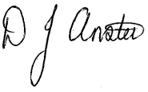
WILLIAMSTOWN PRIMARY SCHOOL
Dinas Isaf West, Tonypandy,
CF40 1AG
Tel: 01443 432186
admin@williamstownprimary.rctcbc.cymru
Tuesday 13th January
Dear Parent/Carer
Happy New Year/Blwyddyn Newydd Dda and welcome back to the start of our new school term! We hope you had a wonderful Christmas break and are ready for an exciting term ahead. I would like to take this opportunity to thank you for the incredible support you showed during our Christmas performances. Your enthusiasm and encouragement made these events truly special for the children. We were also delighted to see so many of you at our first Community Christmas Event, which was a fantastic celebration of togetherness. A special thank you goes to the members of the Penrhiwfer and Williamstown Partnership for their hard work and commitment in making this event such a success. We look forward to hosting more joint events in the coming months to strengthen our community links even further.
This term, we are also investing in improvements to our school building. Over the next few weeks, work will take place in our Heart Space and foyer areas, including redecoration and the introduction of new furniture. These changes are designed to create a purposeful and calm learning environment that supports the development of independence for all our learners. We are excited about the positive impact these improvements will have on the school experience for your children.
Communication
Thank you to everyone who completed our communication survey last term. Your feedback has helped us to launch a new school Facebook page, which will be used to share community and family work, as well as provide key messages and reminders about whole-school events. Clear and effective communication is essential, and we want to ensure you always feel informed and supported. If you have any concerns about your child’s learning or wellbeing, please speak directly to their class teacher in the first instance. For further support, you can contact the relevant Phase Lead:
Mr Stagg – Years 3 to 6 Mr Lewis – Nursery to Year 2
Looking Ahead
This newsletter includes some important dates for the term ahead which, although short, is going to be very busy! It is an exciting term as we prepare for our Eisteddfod, giving us the opportunity to celebrate what it means to be Welsh and to live in Wales. The term will culminate in our very first Spring Fayre – an event we are thrilled to introduce. This will be a wonderful opportunity to purchase crafts, celebrate some of the incredible work of the children, and enjoy a range of community stalls.
Thank you for your continued support. We look forward to working together to make this term a successful and rewarding one for every child.
Sincerely,
Mr D. Anstee
Headteacher
Making a difference together

Slide 2
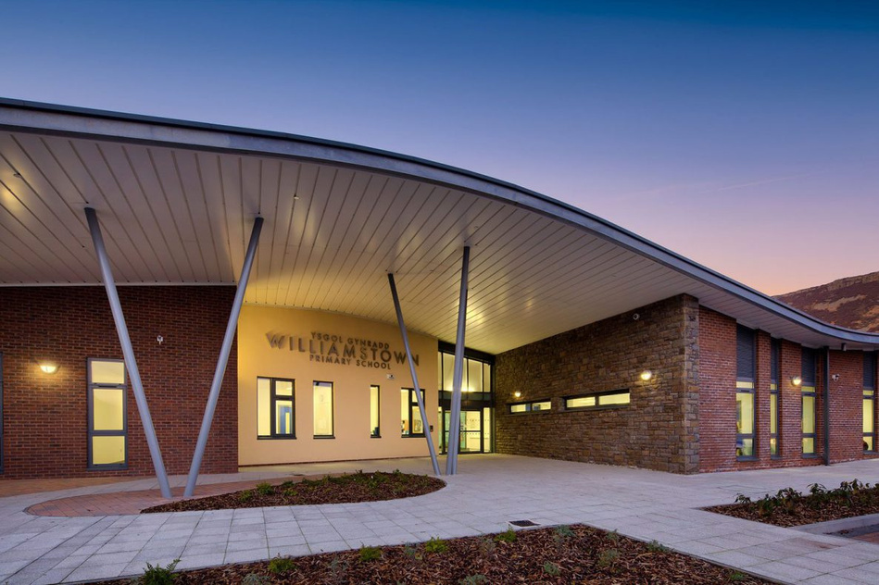
WPS NEWS
January 2026
Attendance
Last half term you would have received an email regarding your child’s attendance. For many of our pupils, their attendance is very good however it is important that all children are in school every day.
We recognise that children can be poorly and there are certain rules around some conditions, especially sickness and tummy bugs but if your child has a cold, sore throat or is feeling under the weather then we promise to look after them. We are happy to provide Calpol if you request this, which can be administered in the school office.
We will always phone you if we think your child should be at home.
Thank you for helping us
Communication
Facebook
Thanks to your input in a recent communication survey, we have launched our new Facebook page that is dedicated to our community and families work and also as a means of sharing information. Our X (Twitter) profile will be closed down this term.
“My Child At School”
The MCAS app is now our principle way of communicating important messages and announcements. You can also use the app to report and track your child’s absences and to email the school.
Google Classroom
Celebrations of your child’s work as well as any home tasks or communication directly from the class teacher will be available on Google Classroom. You will need your child’s hwb log in details to access this. If your child does not know this then please contact your child’s teacher.
Parent Council
Later this term we will be launching our parent council. This will be an opportuntity for a parent representative from each class to work with senior leaders in ensuring our school is the very best it can be for every child. Please look out for more information on this in the coming term.
Volunteers
Do you have some spare time to support your child/grandchild’s class? We are looking for volunteers to support us in school. This support will include listening to readers, helping on school trips or in creative sessions or in any other way that you are able to lend a hand. If you are able to help out then please email CommunityW5@Hwbcymru.net or contact the school for an application pack.

Slide 3
=
Upcoming dates for the diary
w/c 12th Jan Forest School sessions begin (See MCAS for details – Y4-6)
16th January – Nursery meet with parents
2nd February – Fluoride Varnishing (N-Y2)
10th February – Valentines Disco (Times tbc)
13th February – INSET Day (School closed to pupils)
Half Term
27th February – School Eisteddfod
9th March – Parents Week including Eisteddfod display
W/c 9th March – Y6 Cyber Security visit (TBC)
W/c 16th March – Enterprise fortnight
26th March – Spring Fayre (More details to follow)
27th March – Easter Bonnet Parade in the school yard 2:15 – parents may attend (Weather depending)
27th March – Last day of term
Making a difference together

