Slide 1





















Treorchy
Primary School
Parent Newsletter
Welcome Back to
a New School Year
Dear Parents, Carers and Families,
A very warm welcome back to all our pupils and families as we begin a new academic year at Treorchy Primary School. We hope that you enjoyed a restful summer break and are looking forward to the exciting opportunities that the year ahead will bring.
At Treorchy Primary School, our commitment remains firmly focused on providing the very best learning experiences for every child. Through the Curriculum for Wales, we aim to develop ambitious, capable learners who are ready to learn throughout their lives; enterprising, creative contributors; ethical, informed citizens; and healthy, confident individuals.
7 × 5 = 12
3 × 4 = 12
MATHEMATICS
This year, our School Improvement Plan (SIP) focuses on four key priorities that will strengthen teaching, learning and pupil outcomes across the school.
READING
SCIENCE
Together we learn, grow and succeed.

Slide 2











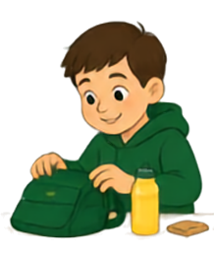










TREORCHY
PAGE 2 OF 6
PRIMARY SCHOOL
School Improvement Plan Priorities
1
Priority 1: Developing Independence and Challenge
This year we will be placing a strong emphasis on helping pupils become more independent learners whilst ensuring that all learning provides the appropriate level of challenge.
What this means for families:
We want our children to:
I CAN
DO IT!
Take greater ownership of their learning.
Develop resilience when faced with challenges.
Apply skills independently across different contexts.
Think critically and solve problems confidently.
Reflect on their learning and identify next steps.
Encourage your child
to take responsibility for simple tasks at home, persevere when things become difficult and celebrate effort as well
as achievement.
Classrooms will provide opportunities for pupils to make decisions, work collaboratively, evaluate their own progress and embrace challenges that extend their thinking. By nurturing independence, we aim to ensure every learner reaches their full potential.
2
Priority 2: Strengthening Mathematics
What this means for families:
Mathematics is a key area of development this year as we continue to design and embed a progressive curriculum that builds deep understanding and confidence.
Simple activities such as counting, discussing time, measuring whilst cooking, handling money and noticing patterns can make a tremendous difference to children's mathematical understanding.
Our focus will be on helping pupils to:
Develop secure number knowledge.
Apply mathematics in real-life situations.
Explain and justify their thinking.
Build confidence in reasoning and problem solving.
Make strong progress from their individual starting points.
7 + 5 = 12
We want mathematics to be meaningful, engaging and challenging, enabling pupils to see the relevance of numeracy in everyday life.

Slide 3





























TREORCHY
PAGE
PARENT NEWSLETTER
3
PRIMARY SCHOOL
SPRING TERM 2025
LEARN • GROW • SUCCEED
OF 6
School Improvement Plan Priorities
Priority 3: Developing Oracy
Communication lies at the heart of learning. Throughout this year, we will be implementing a progressive whole-school approach to oracy.
What this means for families:
Strong speaking and listening skills support learning in every subject and help pupils develop confidence, self-esteem and positive relationships.
We aim to ensure that all pupils can:
Take time to talk with your child about their day, encourage them to explain their thinking and provide opportunities for meaningful conversations at home.
Speak confidently in a range of situations.
Present ideas clearly and effectively.
Participate in discussions and debates.
Build vocabulary across all Areas of Learning and Experience.
Priority 4: Religion, Values and Ethics (RVE)
As part of the Curriculum for Wales, we are continuing to strengthen our Religion, Values and Ethics curriculum.
Our RVE curriculum will help children become respectful and knowledgeable citizens who understand and appreciate different beliefs, values and experiences.
What this means for families:
Through RVE, pupils will:
We encourage open discussions about beliefs, values, culture and identity, helping children appreciate both similarities and differences within our communities.
Explore a range of religious and non-religious worldviews.
Develop understanding, respect and empathy.
Consider important ethical and moral questions.
Learn about diversity within Wales and the wider world.
Develop critical thinking skills and informed perspectives.
Oracy builds confidence. Values shape our future.

Slide 4











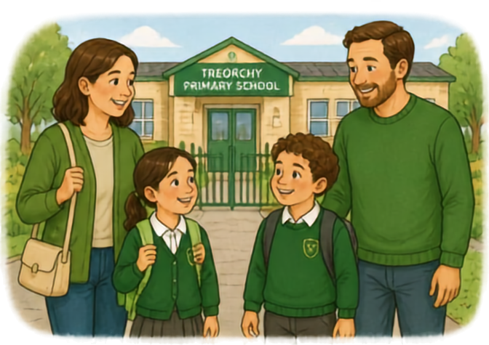
























Trearchy
Reading Matters
PAGE
4
Primary School
PARENT NEWSLETTER
Attendance Matters
Regular attendance remains one of the most important factors in ensuring success at school. Every day in school counts and helps children develop academic skills, friendships and confidence.
TREARCHY
PRIMARY SCHOOL
We ask all families to support us by ensuring children attend school regularly and arrive on time each day.
MIMO - Miss It Miss Out
Working Together
Working Together
for Our Children
The partnership between home and school is essential in helping every child thrive. We look forward to working closely with you throughout the year and sharing the exciting learning experiences that our pupils will enjoy.
Together, we will continue to build a school community where every child is encouraged to be independent, aspire to achieve their best and develop the knowledge, skills and values needed for their future.
4 OF 6

Slide 5







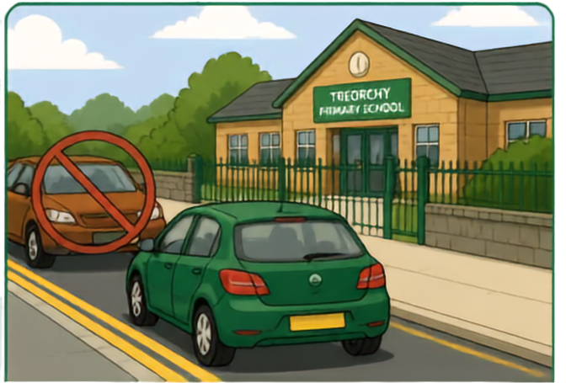

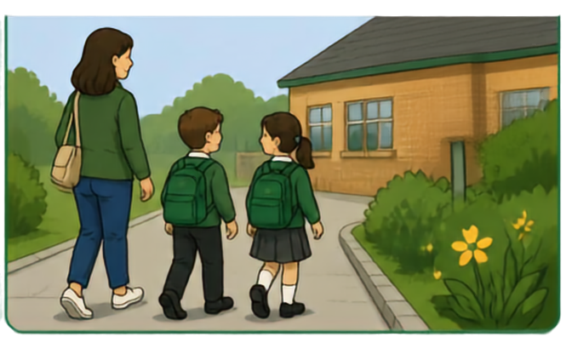






Trearchy Primary School
Together we learn, grow and succeed
Page 5 of 6
Parking and Road Safety Around School
The safety of our children, families and local community is everyone’s responsibility.
We kindly ask all parents and carers to park considerably when dropping off or collecting children from school.
Please do not park on the double yellow lines, across residents’ driveways, on pavements or in areas that restrict visibility for pedestrians and other road users. These measures are in place to keep our children safe, particularly during our busiest times of the day.
Where possible, please walk to school or park a short distance away and complete the final part of your journey on foot.
Thank you for your support in helping us create a safer environment for all members of our school community.
Kindness
Respect
Curiosity
Resilience
Together
5

Slide 6











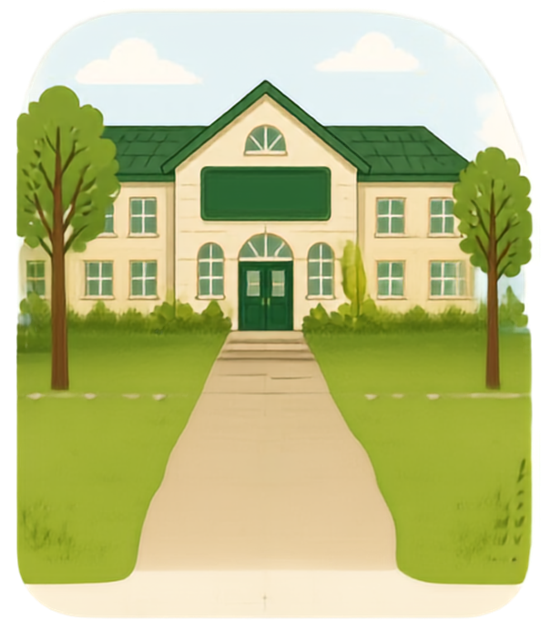

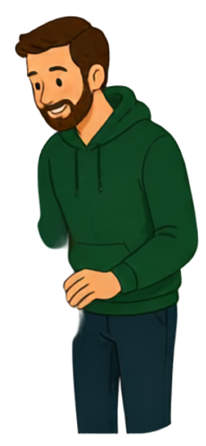














Treorchy
NEWSLETTER
Primary School
Page 6 of 6
Family Organiser
Thank you for your continued support.
TREORCHY
PRIMARY SCHOOL
Best wishes,
E. Anstee
Headteacher Treorchy Primary School
Together we learn, grow and succeed.

